Slide 1
StubHub
Seller flow redesign

Slide 2
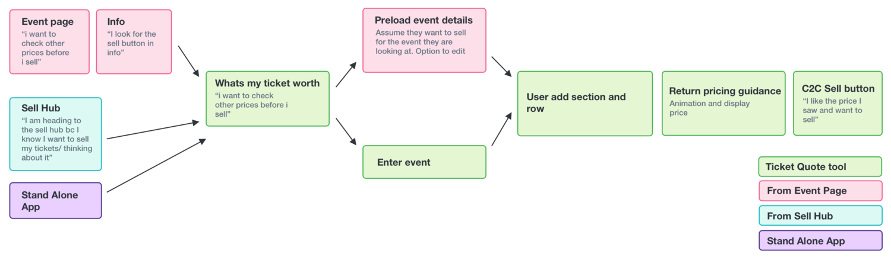
Problem
The experience of selling tickets on the StubHub platform is in need of a redesign. Customers are confused on where to go during specific points of the flow, causing them to drop off and sell elsewhere.
Goal
Redesign the user flow and content to be more accommodating of our large sellers.
Scope
The UX designer will create graphics. Content will strategize copy for each screen.

Slide 3
Problem statement
Sellers are crucial to StubHub’s revenue. However, the seller workflow is in need of a redesign, as users are reporting confusion on content, such as field names and less-than-stellar copy.
StubHub requires a redesign of the seller workflow, including updated copy.
Collaboration
Methods
Jumping hurdles
Reviews

Slide 4
Problem statement
Kick-off meeting with UX, product manager and content.
Content strategy
  Strategist researches other seller flows to check industry standards.
  Strategist connects with A/B testing team to see what customers are saying about current flow.
  Strategist rewrites content for brevity and to appeal to sellers.
Approvals and production
  Final content is approved and sent to engineers.
Collaboration
Methods
Jumping hurdles
Reviews

Slide 5
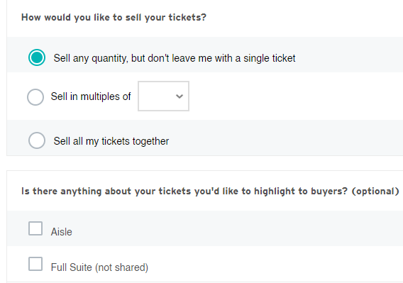
Problem statement
Collaboration
Methods
Jumping hurdles
Customers were formerly confused on what “Additions” meant. Asking the seller if they’d like to add “highlights” makes them more amiable to taking the time to ensure the sale of their tickets.
Reviews

Slide 6
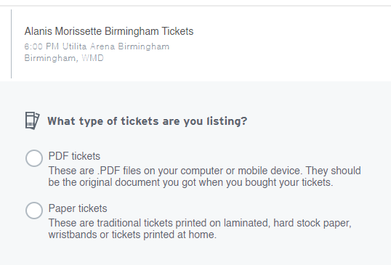
Problem statement
Collaboration
Methods
Jumping hurdles
Customers didn’t know the difference between PDF tickets and paper tickets. By adding a bit of context, we helped sellers understand what kind of tickets they’re selling, ultimately helping with delivery as well.
Reviews

Slide 7
Problem statement
Customers were confused by our one-word descriptions on certain aspects of their journey. While I padded the word count, the new content helped sellers paint a clear picture.
Renaming one section of the flow helped sellers add more “perks” to their listings, increasing their own sales as well as ours.
Collaboration
Methods
Jumping hurdles
Reviews

Slide 8
Problem statement
The creation of new titles and inclusion of more context showed an immediate uptick in sales.
During A/B tests, the customers were very satisfied. They understood where to go and even expressed how easily they could sell on StubHub after the alterations.
Collaboration
Methods
Jumping hurdles
Reviews

