Slide 1
Hawk Ridge Systems
3D printing nurture campaign

Slide 2

Problem
Hawk Ridge Systems wants to leverage its 3D printers and digital manufacturing lab.
Goal
Create email nurture campaigns to sell more printers and increase engagement at DML events.
Scope
The Digital Manufacturing Lab will hold free monthly demos and marketing will create nurture campaigns.

Slide 3
Problem statement
Hawk Ridge Systems’ 3D printer sales have plateaued, even with new products constantly being introduced into the line.
The marketing department requires a set of nurture campaigns to promote the new 3D printing products to its users.
Collaboration
Methods
Jumping hurdles
Reviews

Slide 4
Problem statement
Kick-off meeting with Digital Manufacturing team, marketing and CEO to discuss scope of project.
Content strategy
  Digital Content Manager meets with DML team and application engineers to discover what customers look for in additive manufacturing.
Approvals and release
  Marketing and DML team approves the nurture campaigns and they are sent out to consumers.
Collaboration
Methods
Jumping hurdles
Reviews

Slide 5
Problem statement
3D Printing offers transformative advantages at every phase of creation, from initial concept design to production of final products and all steps in between. Know what you want but not what you need? Don’t worry – just check out our 3D Printer Buyer’s Guide for every question!
Collaboration
Methods
The DML team mentioned that some engineers have trouble getting started with their projects. So, offering customers a guide on how to begin was a solid choice for the first nurture campaign.
Jumping hurdles
Reviews

Slide 6
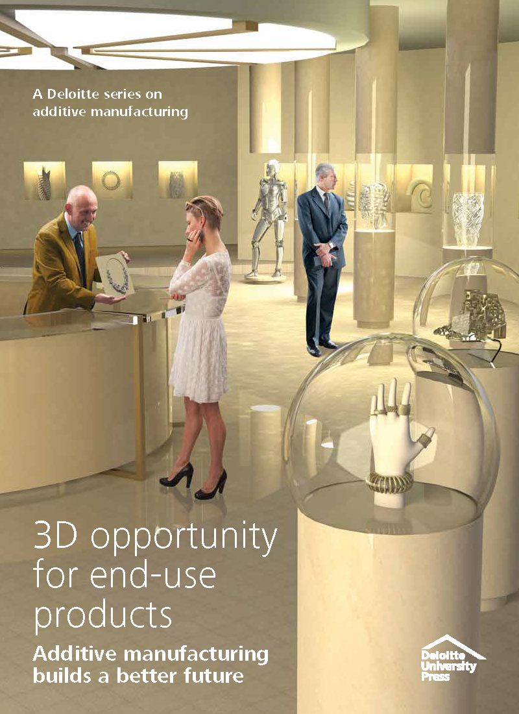
Problem statement
Product evolution never looked so innovative! 3D printing has helped a multitude of big box retailers and small companies alike improve their competitiveness. Still need convincing? Just read this Deloitte whitepaper to prove the speed and profitability of 3D printing!
Collaboration
Methods
Jumping hurdles
Letting the customer know that our company can help them, big retailer or small family-owned business, was a good choice for offering products to a wide audience.
Reviews

Slide 7
Problem statement
Customer retention is falling in the 3D printing space, as consumers don’t know we sell printers.
New customers numbers in the 3D printing space are abysmal.
Customers don’t feel a smaller company can help them.
Collaboration
Methods
Jumping hurdles
Reviews

Slide 8
Problem statement
Once the nurture campaigns were launched, we saw an immediate uptick in email openings and engagement.
Attendance to the Digital Manufacturing Lab Open Houses increased exponentially.
Our revenue for 3D printer purchases skyrocketed, and we were able to secure a deal with Hewlett Packard.
Collaboration
Methods
Jumping hurdles
Reviews

