Slide 1
Guckenheimer
Catering user guide

Slide 2


Problem
Guckenheimer chefs are having trouble uploading their menus to the website. Often times, they’ll upload the incorrect file, which crashes their site.
Goal
Create a Catering user guide for chefs to follow.
Scope
IT will provide support for the Catering system and Web Admin will create the guide.

Slide 3
Problem statement
Guckenheimer’s IT department manages the internal sites of all its clients. While an internal site isn’t required, it serves as a source of truth for chefs and users alike.
The back-end system for the chefs can be difficult to use, often causing the internal site itself to crash.
Guckenheimer requires a user guide for the uploading of menus, so chefs no longer have to spend hours navigating the system.
Collaboration
Methods
Jumping hurdles
Reviews

Slide 4
Problem statement
Kick-off meeting with IT to discuss the various issues chefs are facing.
Content strategy
  Web admin follows the user flow, documenting the steps as they go.
  Web admin creates a presentation to help chefs follow along.
Approvals and release
  IT approves the presentation and it is sent out to all chefs within the company.
Collaboration
Methods
Jumping hurdles
Reviews

Slide 5
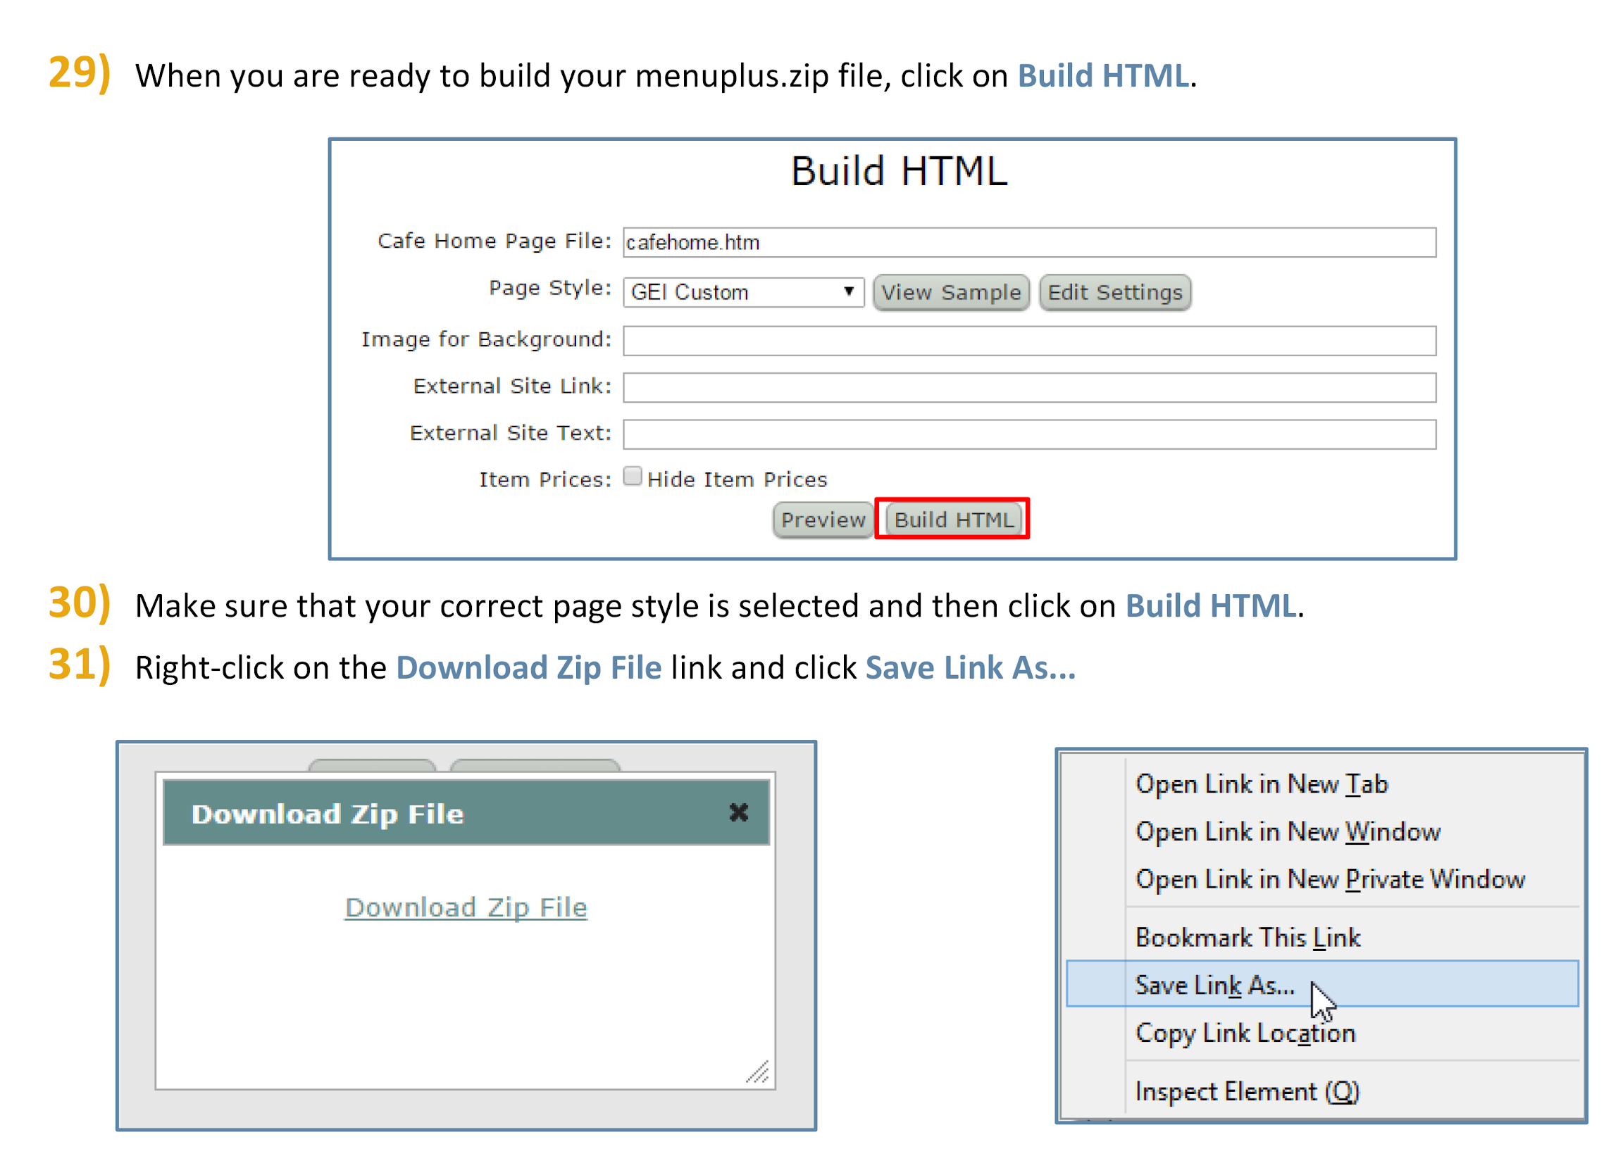
Problem statement
Collaboration
Methods
Jumping hurdles
Once the chefs would upload their menu to their particular cafe, they would become stuck once required to upload it to their internally-hosted website.
Reviews

Slide 6
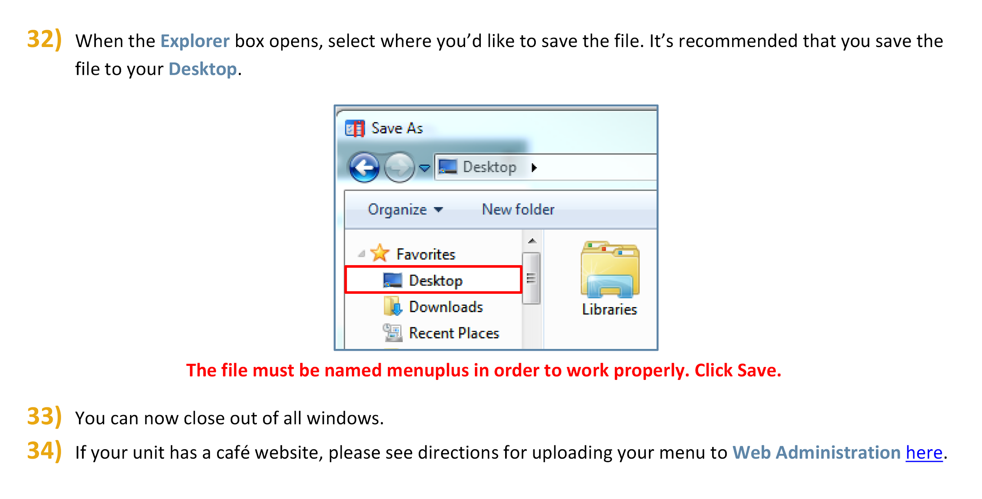
Problem statement
Collaboration
Methods
Jumping hurdles
By creating a note marked in red to show each chef where to save their menu and under what name, we anticipated they’d be able to upload their menus without IT help.
Reviews

Slide 7
Problem statement
Chefs are confused on how to not only fill out their menus, but also how to upload them.
The confusion is causing 404 errors on the internal sites, because the file names are in the incorrect taxonomy.
IT is burning many hours checking the internal sites and calling each chef to walk them through the process.
Collaboration
Methods
Jumping hurdles
Reviews

Slide 8
Problem statement
After the release of the MenuPlus User Guide on the internal Guckenheimer site, chefs called in to tell us how easy it was to upload their menus.
The calls to IT decreased by 70%.
The 404 errors also decreased significantly.
Collaboration
Methods
Jumping hurdles
Reviews

